Slide 1
What have the ETF ever done for us!!!!
PAUL STYCH, Regional Specialist Lead for SOUTH WEST AND WEST MIDLANDS
Dianne ROBINSON, REGIONAL SPECIALIST LEAD FOR THE EAST MIDLANDS
5TH DECEMBER 2019
Notes:
https://educationendowmentfoundation.org.uk/tools/guidance-reports/maths-ks-two-three/#recommendation-1

Slide 2
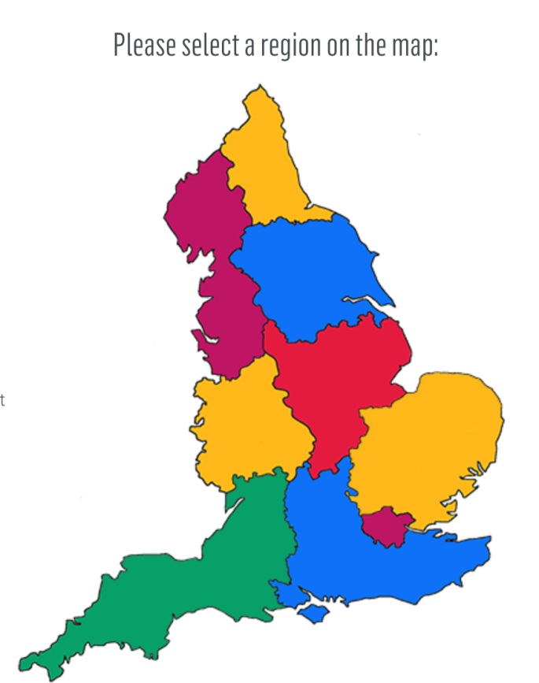
Find your Regional specialist lead
Work with you to identify training needs and advise on appropriate solutions within the ETF offer including free and subsidised:
http://www.et-foundation.co.uk/supporting/support-practitioners/maths-and-english-pipeline/regional-specialist-leads/

Slide 3
Welcome
Today we will be:
introducing how the Education and Training Foundation supports the FE Sector
considering English and maths in context(s)

Slide 4
What issues are you facing?
In each envelope you will have a set of statements which reflect some of the common concerns which providers are currently faced with
Discuss this in your tables
Rank the statements in the form of a diamond 9 with the highest ranking concern at the top
You have 15 minutes for this activity

Slide 5
What issues are you facing?
Engagement and motivation of learners?
Progress on course?
Support for Vocational tutors?
Shortage of trained staff?
Management expertise for this demanding agenda?
Limited budgets?
Keeping up to date

Slide 6
Maths and English CPD
WHAT WOULD YOU CHOOSE?
IF YOU COULD HAVE ANY TYPE AND FORMAT OF CPD ON YOUR DOORSTEP, WHAT WOULD IT BE?

Slide 7
ETF offer of support
Open, inhouse, bespoke courses
Webinars
Online materials and support
Network events
https://www.et-foundation.co.uk/supporting/support-practitioners/maths-and-english/courses/

Slide 8
Foundation Online modules

Slide 9
Foundation Online – maths modules

Slide 10
Foundation Online – English modules

Slide 11
https://www.et-foundation.co.uk/supporting/support-practitioners/edtech-support/enhance-digital-teaching-platform/

Slide 12
Keeping up to date
Contact your RSL
Networks
Monthly email updates
and… just about anything else!
JUST ASK

Slide 13
Paul Stych Dianne Robinson

